Slide 1
Approximation algorithms 3 Vertex cover, TSP, k-center
CS240 Spring 2021
Rui Fan

Slide 2
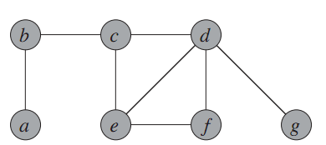
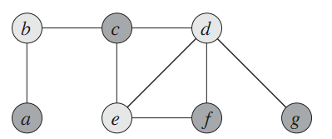
Vertex cover
Input A graph with vertices V and edges E.
Output A subset V’ of the vertices, so that every edge in E touches some vertex in V’.
Goal Make |V’| as small as possible.
Finding the minimum vertex cover is NP-complete.
Vertex cover is a special case of (unweighted) set cover, where each element (edge) can be covered by at most two sets (vertices).
We’ll see a simple 2 approximation for this problem.
source: Introduction to Algorithms, Cormen et al.

Slide 3
A vertex cover algorithm
Initially, let D be all the edges in the graph, and C be the empty set.
C is our eventual vertex cover.
Repeat as long as there are edge left in D.
Take any edge (u,v) in D.
Add {u,v} to C.
Remove all the edges adjacent to u or v from D.
Output C as the vertex cover.

Slide 4
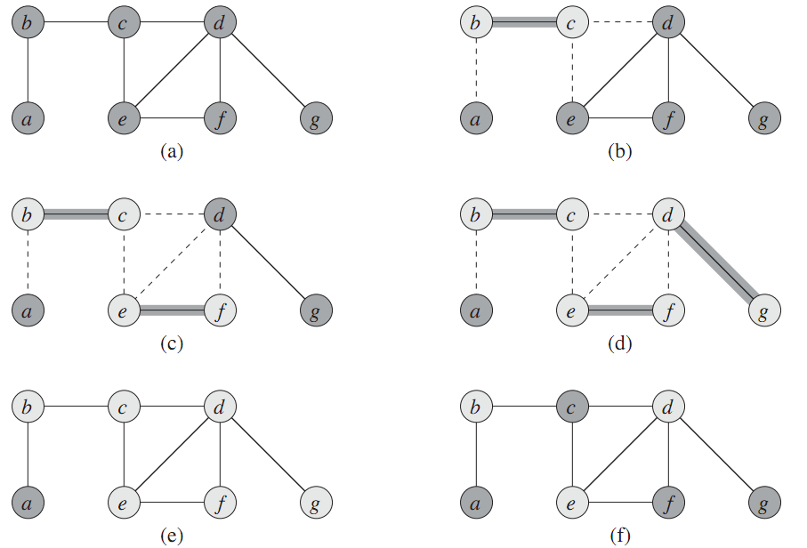
Example
source: CLRS
Algorithm’s vertex cover
Optimal vertex cover

Slide 5
Proof of correctness
The output is certainly a vertex cover.
In each iteration, we only take out edges that get covered.
We keep adding vertices till all edges are covered.
Now, we show it’s a 2 approximation.
Let C* be an optimal vertex cover.
Let A be the set of edges the algorithm picked.

Slide 6
Proof of Correctness
None of the edges in A touch each other.
Each time we pick an edge, we remove all adjacent edges.
So each vertex in C* covers at most one edge in A.
The edges covered by a vertex all touch each other.
Every edge in A is covered by a vertex in C*.
Because C* is a vertex cover.
So |C*| ≥ |A|.
The number of vertices the algorithm uses is 2|A|.
If alg picks edge (u,v), it uses {u,v} in the cover.
So (# vertices alg uses) / (# vertices in opt cover) = 2|A| / |C*| ≤ 2|A| / |A| = 2.

Slide 7
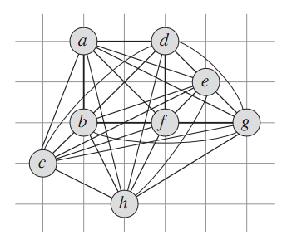
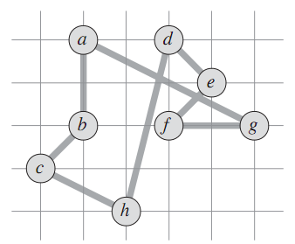
Traveling Salesman Problem
Input A complete graph with weights on the edges.
Output A cycle that visits each city once.
Goal Find a cycle with minimum total weight.
source: CLRS

Slide 8
Metric TSP
TSP is NP-hard. In fact, it’s even NP-hard to approximate when weights can be arbitrary.
However, TSP is approximable for special types of weights.
A weighted graph satisfies the triangle inequality if for any 3 vertices p, q, r, we have d_{pq}+d_{qr} ≥ d_{pr}.
I.e., direct path is always no worse than a roundabout path.
This is called a metric TSP.
There is a 1.5-approx algorithm for TSP in graphs with the triangle inequality.
Let’s look at a simpler 2-approx first.
q
r
p

Slide 9
A 2-approximation for TSP
Construct a minimum spanning tree T on G.
Use depth-first traversal to visit all the vertices in T, starting from an arbitrary vertex.
Convert this depth-first traversal T’ to a cycle H that doesn’t revisit any vertex.
Return H as the TSP tour.

Slide 10
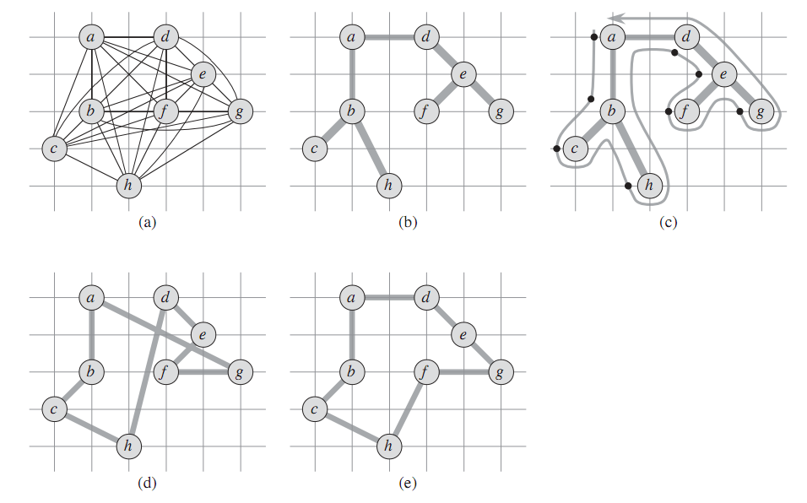
Example
source: CLRS
(b) The MST T.
(c) visit T in order abcbhbadefegeda.
(d) converts the tour from (c) to a Hamiltonian cycle, that doesn’t revisit any vertices.
(e) is the optimal TSP.

Slide 11
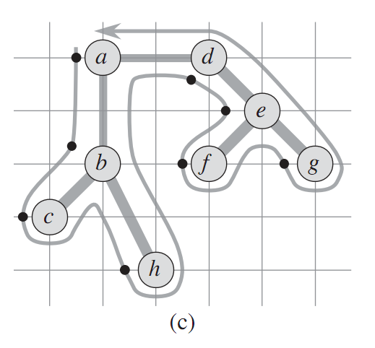
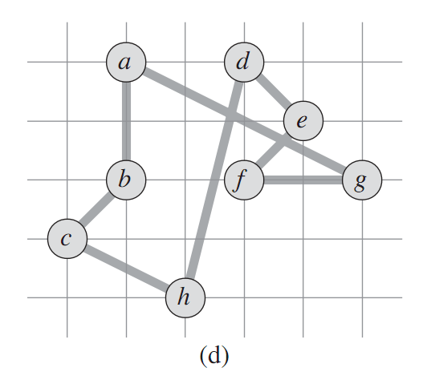
Making the tour Hamiltonian
To go from (c) to (d), we need to make a tour T’ that revisits vertices into a cycle H that doesn’t revisit vertices.
We use shortcutting.
If we revisit a vertex in T’, we directly jump to the next vertex in T’ we haven’t visited.
We allow revisiting the first vertex.
The sequence of vertices we now visit is H.
Ex abcbhbadefegeda → abchdefga.

Slide 12
Making the tour Hamiltonian
Lemma If H is the shortcut of T’, then c(H)≤c(T’).
Proof We formed H from T’ by skipping over some vertices. E.g. we directly went from c to h, skipping over b.
But by the triangle inequality, d_{cb}+d_{bh} ≥ d_{ch}.
So shortcutting from c to h didn’t increase the distance.
The same thing applies to all our shortcuts.
So H is no longer than T’.

Slide 13
Proof of 2-approximation
Let H* be an optimum TSP.
If we delete an edge from H*, we get a spanning tree.
Since T is an MST, c(T) ≤ c(H*).
Call the path from the depth-first traversal T’.
T’ crosses each edge in T twice.
So c(T’) = 2 c(T).
Let H be the outcome of shortcutting T’.
H is a Hamiltonian cycle. It visits all the vertices, and ends where it started.
c(H) ≤ c(T’), by the lemma.
c(H) ≤ c(T’) = 2 c(T) ≤ 2 c(H*).
So H is a 2-approximation.

Slide 14
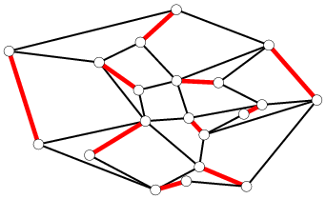
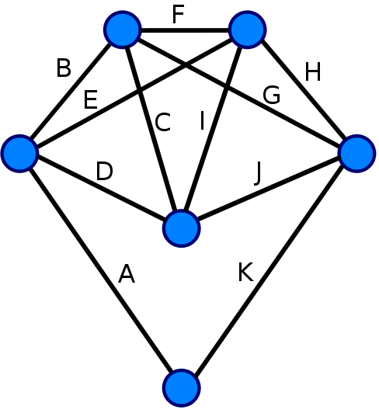
Matchings and Euler cycles
A matching in a graph is a set of nonintersecting edges.
A perfect matching is a matching that includes every vertex.
An Euler tour of a graph is a path that starts and ends at the same vertex, and visits every edge once.
Hamiltonian tour visits every vertex once.
Thm (Euler) A graph has an Euler tour if and only if all vertices have even degree.
Note how deciding if graph has Euler tour is trivial, but deciding if it has Hamiltonian tour is NPC!

Slide 15
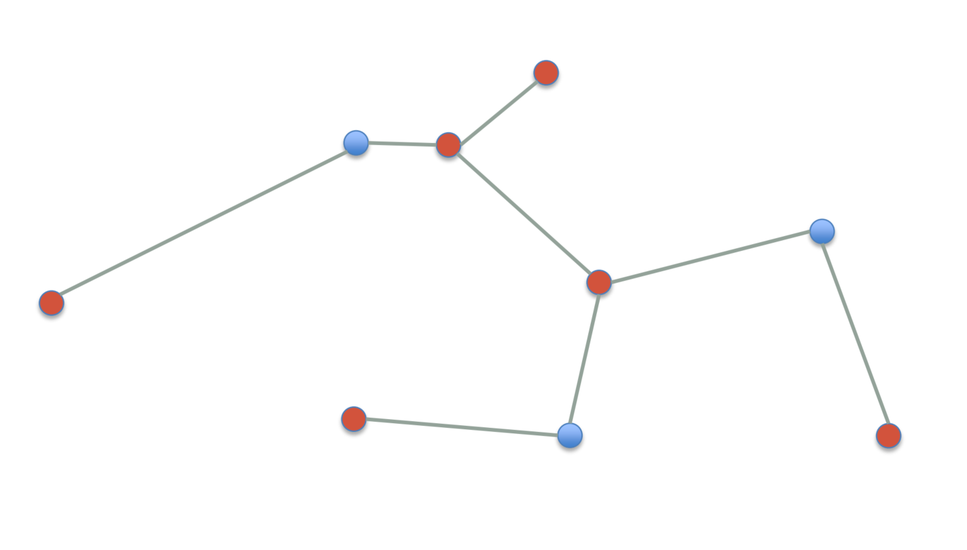
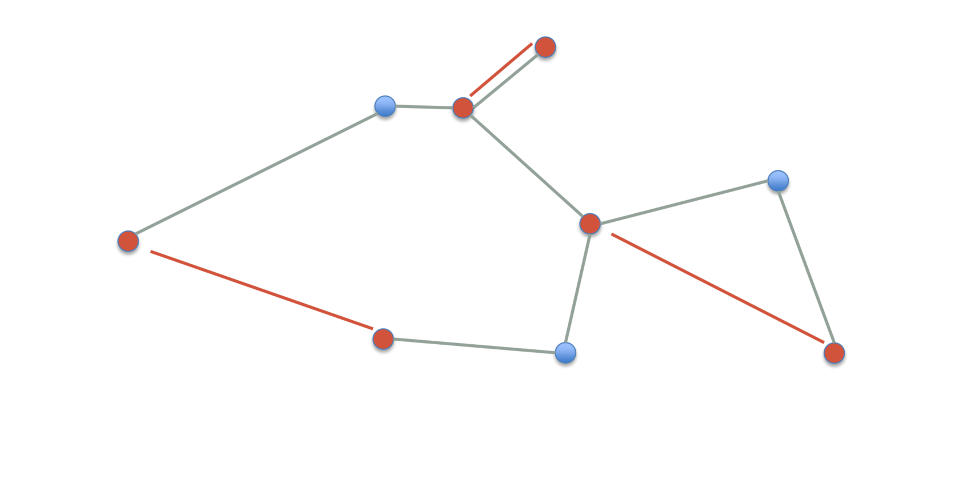
Christofides 3/2-approx algorithm
A 3/2-approximation for TSP with triangle inequality.
Construct a minimum spanning tree T on G.
Find the set V’ of odd degree vertices in T.
Construct a minimum cost perfect matching M on V’.
Add M to T to obtain T’.
Find an Euler tour T’’ in T’.
Shortcut T’’ to obtain a Hamiltonian cycle H. Output as the TSP.

Slide 16
Why Christofides works well
In the 2-approx, we found a TSP by “doubling” the MST to an Euler tour, then shortcutting.
We need to start with Euler tour before shortcutting to ensure we visit all cities.
Key to Christofides is to find a shorter Euler tour, without doubling the MST.
A graph with only even degree vertices always has Euler tour.
So we want to modify the MST to have all even degrees, by adding a matching.
Euler tour thru all edges
shortcutting
Hamiltonian tour thru all cities

Slide 17
Proof of correctness
Lemma T’ has an Euler tour.
Proof There are an even number of vertices in V’, because the total degree of T is even.
Since G is a complete graph and |V’| is even, there’s a perfect matching on V’.
The min cost perfect matching can be found in O(n²) time using the blossom algorithm.
The degree of every node in M is odd. Since V’ are the odd degree nodes in T, adding M to T makes all nodes in T’ have even degree.
T’ has Euler tour by Euler’s theorem.

Slide 18
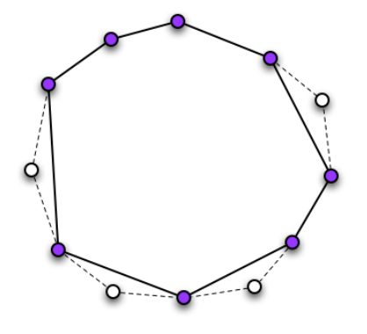
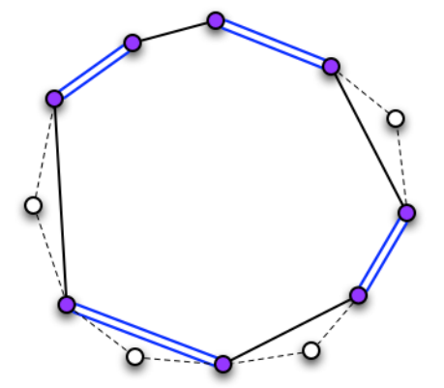
Proof of correctness
Lemma Let H* be an optimal TSP on G, and let m be the cost of M. Then m ≤ c(H*)/2.
Proof Let H’ be the optimal TSP on V’.
c(H’) ≤ c(H*) because H’ is an optimal TSP on fewer vertices.
H’ is a cycle on V’, so it consists of two matchings on V’. The cheaper one has cost m’ ≤ c(H’)/2 ≤ c(H*)/2.
m ≤ m’ because M has min cost.
http://www.mpi-inf.mpg.de/departments/d1/teaching/ss12/AdvancedGraphAlgorithms/Slides06.pdf

Slide 19
Proof of 3/2-approximation
Thm Let H be the TSP output by Christofides and let H* be an optimal TSP. Then c(H) ≤ 3/2*c(H*).
Proof
c(T) ≤ c(H*) because T is an MST.
c(T’) = c(M) + c(T) ≤ c(H*)/2 + c(H*) = 3/2*c(H*).
c(H) ≤ c(T’) because H is the shortcut of T’.
Construct a minimum spanning tree T on G.
Find set V’ of odd-degree vertices in T.
Construct a minimum cost perfect matching M on V’.
Add M to T to obtain T’.
Shortcut T’ to obtain a Hamiltonian cycle. Output as the TSP.

Slide 20





k-Center problem
Given a city with n sites, we want to build k centers to serve them.
Let S be set of sites, C be set of centers.
Each site uses the center closest to it.
Distance of site s from the nearest center is d(s,C) = min_{c∈C} d(s,c).
Goal is to make sure no site is too far from its center.
We want to minimize the max distance that any site is from its closest center.
Minimize r(C)=max_{s∈S} min_{c∈C} d(s,c).
C is called a cover of S, and r is called C’s radius.
Where should we put centers to minimize the radius?
Assume distances satisfy triangle inequality.
p
q
≤ p+q
r(C)

Slide 21
Gonzalez’s algorithm
k-Center is NP-complete.
We’ll give a simple 2-approximation for it.
Idea Say there’s one site that’s farthest away from all centers. Then it makes the radius large. We’ll put a center at that site, to reduce the radius.
Note we allow putting center at same location as site.

Slide 22
Gonzalez’s algorithm
C is set of centers, initially empty.
repeat k times
choose site s with maximum d(s,C)
add s to C
return C
Note The centers are located at the sites.

Slide 23
Proof of correctness
Let C be the algorithm’s output, and r be C’s radius.
r = max_{s∈S} min_{c∈C} d(s,c)
Lemma 1 For any c,c’∈C, d(c,c’)≥r.
Proof Since r is the radius, there exists a point s∈S at distance ≥ r from all the centers.
If there’s no such s, then C’s radius < r.
So s is distance ≥ r from c and c’.
Suppose WLOG c’ is added to C after c.
If d(c,c’)<r, then algorithm would add s to C instead of c’, since s is farther.
c
< r
c’
≥ r
≥ r
s

Slide 24
Proof of correctness
Cor There exist k+1 points mutually at distance ≥ r from each other.
By the lemma, the k centers are mutually ≥ r distance apart.
Also, there’s an s∈S at distance ≥ r from all the centers.
Otherwise C’s covering radius is < r.
So the k centers plus s are the k+1 points.
Call these k+1 points D.

Slide 25
Proof of correctness
Let C* be an optimal cover with radius r*.
Lemma 2 Suppose r > 2r*. Then for every c∈D, there exists a corresponding c’∈C*. Furthermore, all these c’ are unique.
Proof Draw a circle of radius r/2 around each c∈D.
There must be a c’∈C* inside the circle, because
c is at most distance r* away from its nearest center, since r* is C*’s radius.
r/2>r*.
Given c₁,c₂∈D, let c’₁,c’₂∈C* be inside c₁ and c₂’s circle, resp.
c₁ and c₂’s circles don’t touch, because d(c₁,c₂) ≥ r.
So c’₁≠c’₂.
c₁
r/2
c’₁
≥ r
r/2
c’₂
c₂

Slide 26
Proof of correctness
Thm Let C be the output of Gonzalez’s algorithm, and let C* be an optimal k-center. Then r(C) ≤ 2r(C*).
Proof By Lemma 2, if r(C)>2r(C*), then for every c∈D, there is a unique c’∈C*.
But there are k+1 points in D, by the corollary.
So there are k+1 points in C*. This is a contradiction because C* is a k-center.

